Slide 1
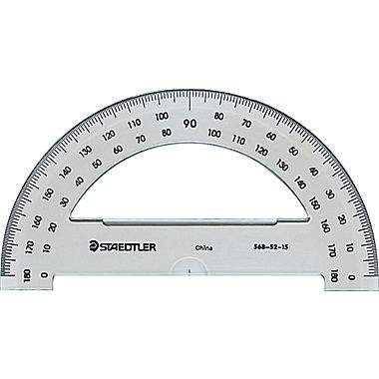
Find where you would align the line that form an angle; draw a line.
Find where you would align the corner that form an angle; mark with an X.

Slide 2
Draw a 45˚ angle below using a protractor.
Measure the following angles and write them down.
This side
This side
Draw a 90˚ angle below using a protractor.
This side

Slide 3
Target
Where should you put the flashlight so you hit the mirror first and then the target?
Draw the path of the light accurately using a protractor.
Mirror

Slide 4
Where should you put a mirror so you hit the mirror first and then the target?
Draw the path of the light accurately using a protractor.
Target

Slide 5
Where does the light go?
Draw the light rays accurately using a protractor and see if it hits the target!

